Slide 1

Earth's Most Customer- centric Company
- Group One
Sept 7, 2018

Slide 2


Members of Group One
Bishal Khadka
Khum Khatri
Manish Tuladhar
Rabin Bhandari

Slide 3
Contents to be discussed
Introduction
How Amazon began? (History)
Where Amazon stands today?
How Amazon does it all?
Business model and structure
Products and Services

Slide 4
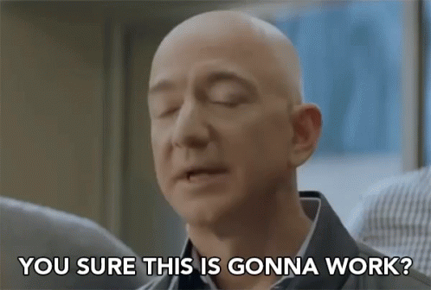
Does anyone know who this guy is?
Jeff Bezos
- CEO & Founder of Amazon.com

Slide 5
Who are Amazon?
Amazon.com, is an American electronic commerce and cloud computing company based in Seattle, Washington, that was founded by Jeff Bezos on July 5, 1994.
Produces consumer electronics like Kindle, Fire tablets, Fire TV and Echo, and is also the world's largest provider of cloud infrastructure services (IaaS and PaaS).
Now after twenty three years, Amazon has a revenue of 177.9 billion USD.

Slide 6
Company Overview
Founded in
1994 in Seattle, USA
566,000 employees worldwide
Global leader in
E-commerce
Wide range of products worldwide
Worldwide network of fulfillment
Mass customization
Customer Experience
Affiliations and business models
Amazon Services

Slide 7

History Of Amazon
Time period | Key developments at Amazon
1994–1998 | Starts off as an online bookstore selling books Competing with local booksellers and Barnes & Noble.
1998–2004 | Expands its services beyond books by also offering convenience services, such as Free Super Savers Shipping.
2005–2011 | Cloud computing area with Amazon AWS: Dominates and controls the most of physical infrastructure of internet. Offers the Amazon Kindle for eBooks: By 2010, more people buy eBooks than physical books off of Amazon.
2011–2015 | Offers streaming services like Amazon Music and Amazon Video. By 2015, its market capitalization surpasses that of Walmart.

Slide 8
"Amazon" wasn't the company's original name.
Jeff Bezos originally wanted to give the company the magical sounding name "Cadabra."
Bezos also favoured the name "Relentless." If you visit Relentless.com today, guess where it navigates to...
He finally choose "Amazon" because he liked that the company would be named after the largest river in the world, hence the company's original logo.

Slide 9
Amazon’s first homepage

Slide 10
Early Working Days
Amazon’s first office building
In the early days of Amazon, a bell would ring in the office every time someone made a purchase, and everyone would gather around to see if they knew the customer.

Slide 11
Seattle headquarters building

Slide 12
Where Amazon stands today?
The world's leading E-commerce company today, with over 566,000 employees and last year company's net revenue was almost 178 billion U.S. dollars.
Internet stores and services around the world.
In total trade volume, it consumes about one-third of the world goods.
Amazon FBA and warehouses.
Amazon Web Services.
Amazon Products like Kindle, Fire, Alexa, Echo etc.

Slide 13
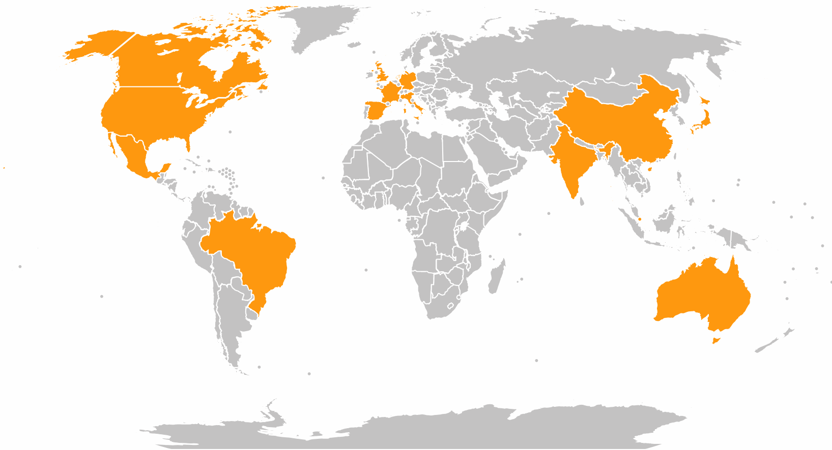
Amazon Site Global Availability

Slide 14

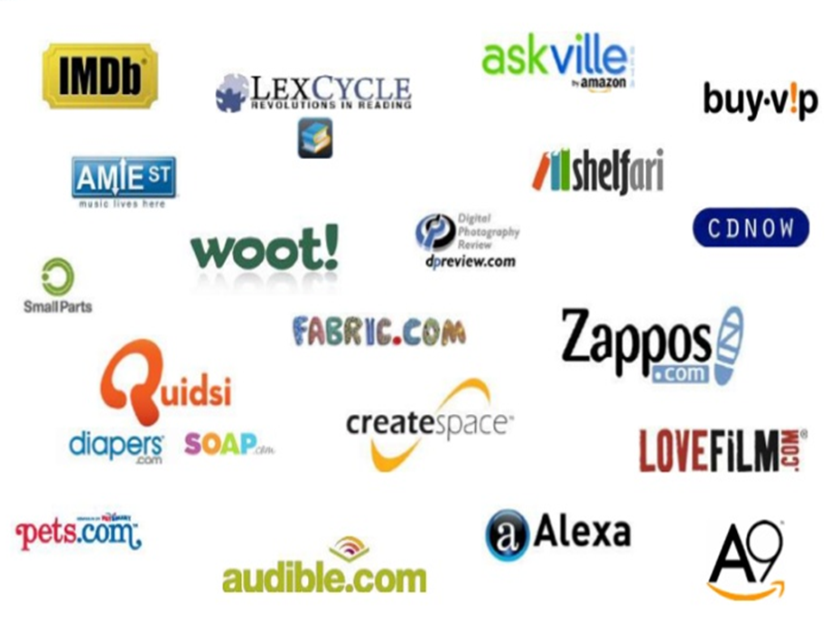
Did you know all these companies belong to Amazon?

Slide 15
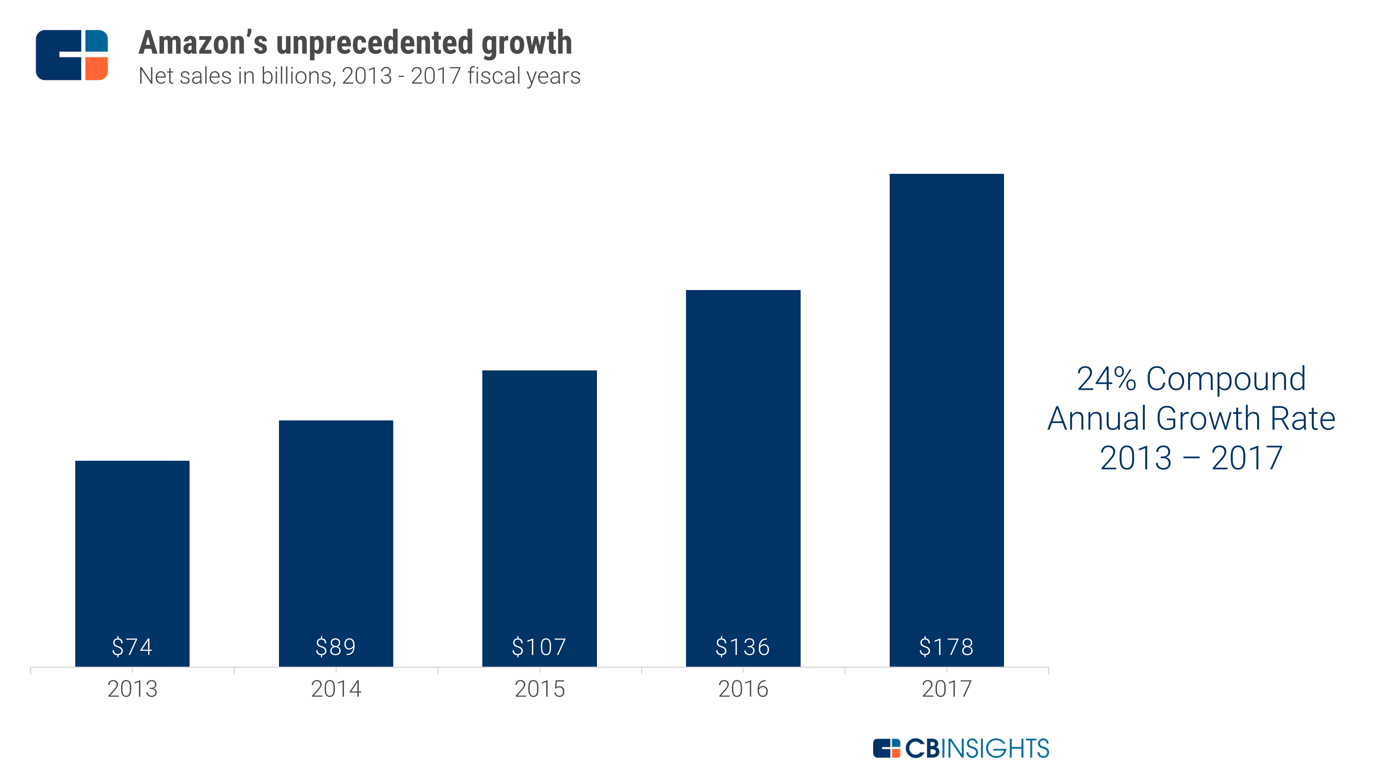
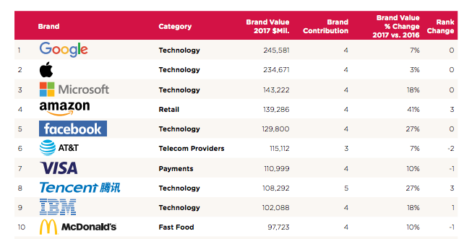
Financial Growth

Slide 16
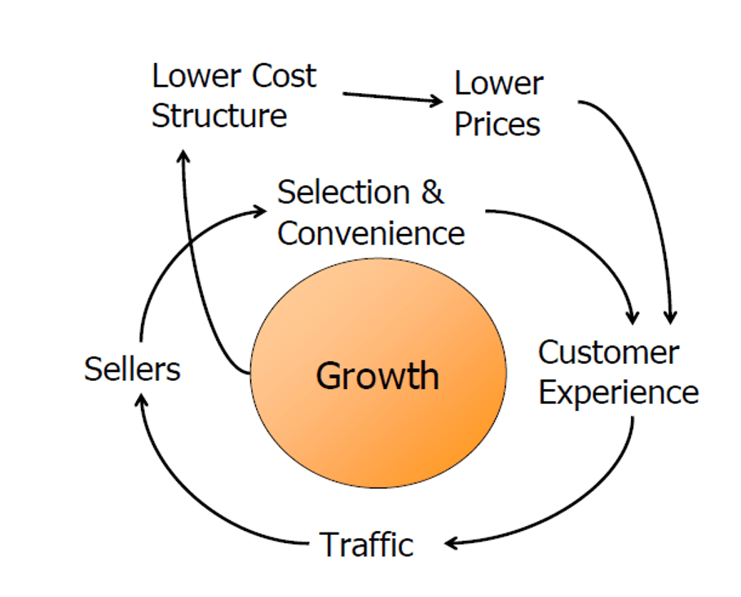

How Amazon does it all?
Three Customer Sets:
Consumers: Who buy products on Amazon (including Amazon’s products).
Sellers: Who want to sell products on Amazon (including Amazon)
Developers: Who want to use Amazon’s developing services like Developing websites/portals, Hosting, Web Services, S3(Storage), Checkout Services, etc.
Strategy
(actually was wrote on a napkin sketch)

Slide 17
Amazon’s E-Commerce
Amazon conducts its practices with other parties into following way:
Business to Consumer (B2C)
Amazon.com : offering to sell vast range of products
Kindle e-reader and e-books
Amazon prime service with discount feature and free shipping
Business to Business (B2B)
FBA program of Amazon with certain fee
Amazon payments and supply service
Amazon Web Service (Cloud services platform, offering compute power, database storage)

Slide 18
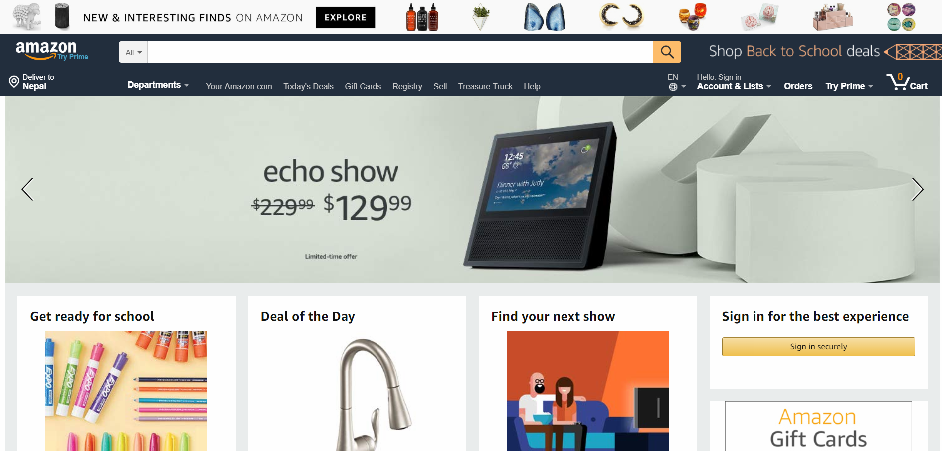

Consumers: Amazon.com
A tremendous product range.
The webpage is set up with
Customer Personalization
Customer tracking
Gift-giving recommendations
Community between users (Reviews and recommendations)
Branch websites depending on products and services like :
Amazon Music
Amazon Fresh
Kindle
Echo
Alexa

Slide 19
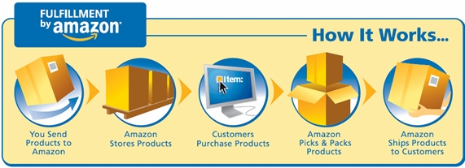
Sellers: Amazon FBA program
FBA gives users the ability to grow their business and reach more customers.
This in return helps Amazon to earn on FBA charge plans.
Benefits:
Discounted Shipping Rates
Customer Service and Return Management
Multi-Channel Amazon Fulfillment for your own website

Slide 20
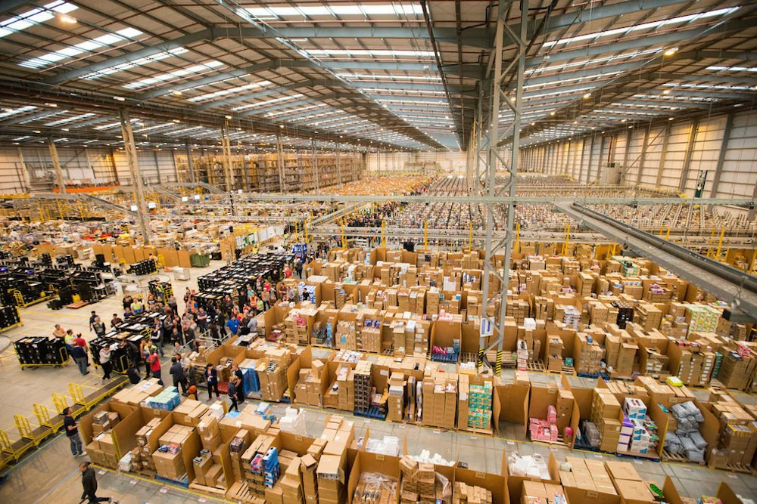
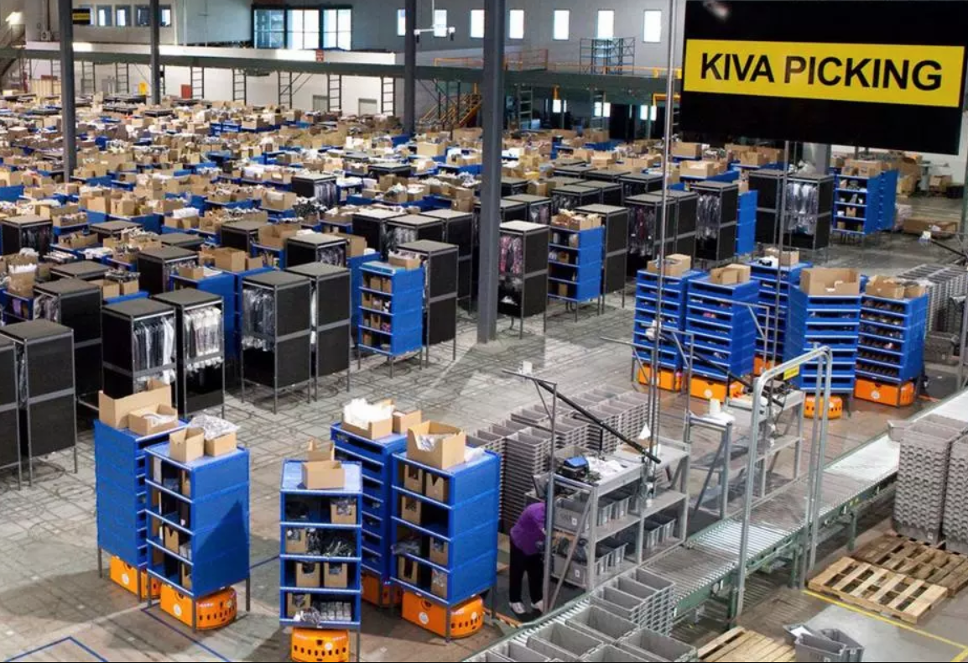
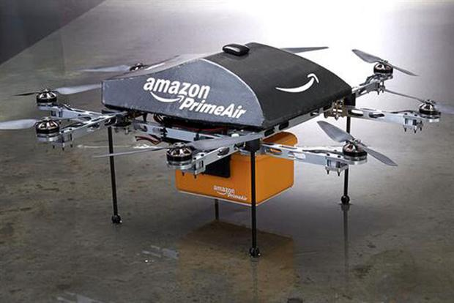
Amazon Warehouse
Largest warehouse and largest building in the world covers 4.3 million sq. ft. i.e. 655.32 km length.
Ships more than 1 million items a day during holidays.

Slide 21
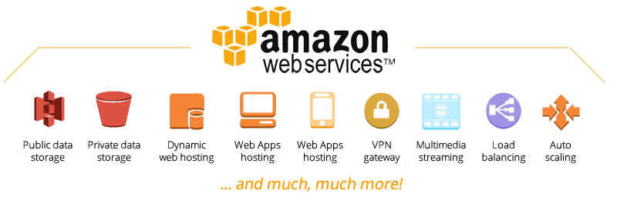
Developers: AWS and Associates
Amazon Web Services (AWS) is a secure cloud services platform.
Offers compute power, database storage, content delivery and other functionality.
This help businesses scale and grow by expanding horizon on a global scale.

Slide 22
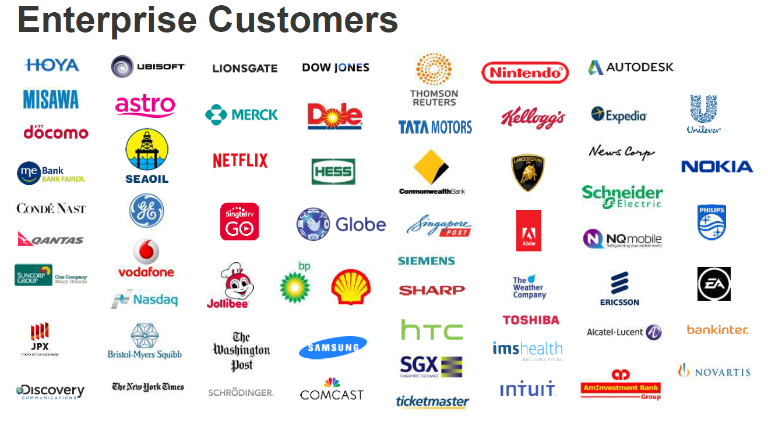
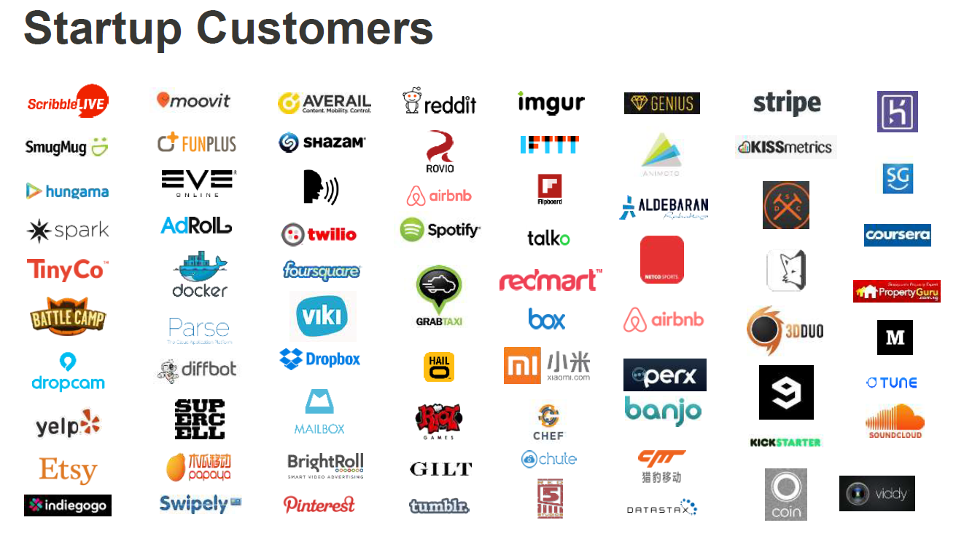
Enterprise Customers
Startup Customers

Slide 23
Amazon’s E-Business Models
Amazon conducts its practices with other parties into various ways making it compiled with most of the business models.
Transaction Feel Model
Amazon FBA program
AWS
Subscription model
Amazon Prime
AWS
Advertisement Model
Amazon Associates
AWS
Affiliate model
Affiliate to different companies
Electronic Tendering System
Amazon Prime with shipping
Amazon Cart System/ Gift cards
Group Purchasing
Discount on mass products
Holidays like Black Friday, Christmas

Slide 24
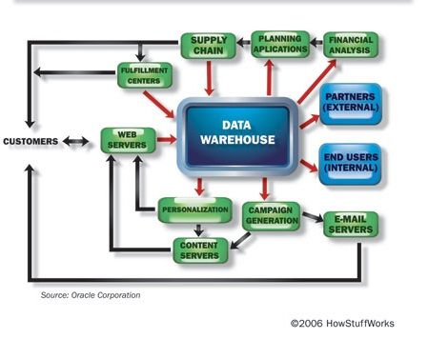
Amazon Technology
Four software development centers worldwide
Amazon running is entirely Linux-based
Amazon employs the Netscape Secure Commerce Server using the SSL protocol.

Slide 25

Products And Services
Retail
Books, music and movies
Consumer Electronics
Computer and office
Tools and automotive
Food and household
Home Improvement
Toys and Video Games
Sports and Fitness
Clothing and Jewelry
Kids and baby
Kindle
Non Retail
Referrals/Commission based selling and movies
Amazon Web Services (AWS)
Fulfillment by Amazon (Services to Businesses)

Slide 26
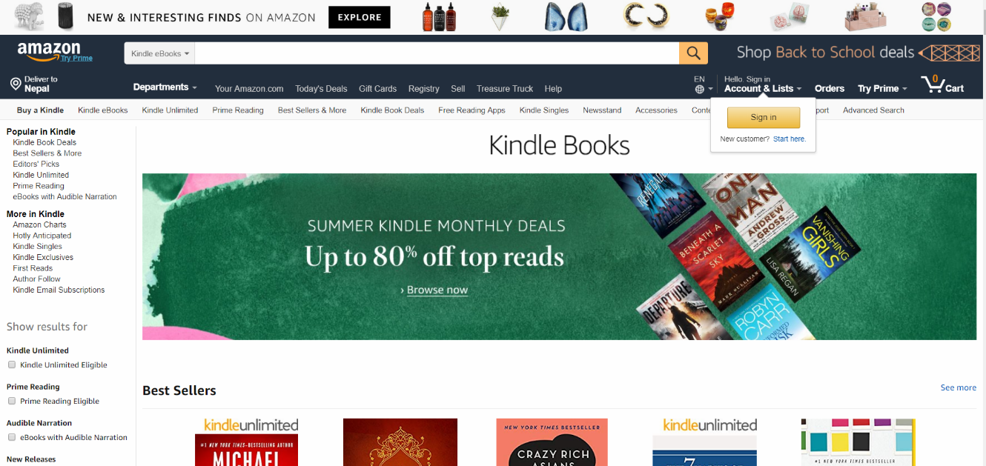
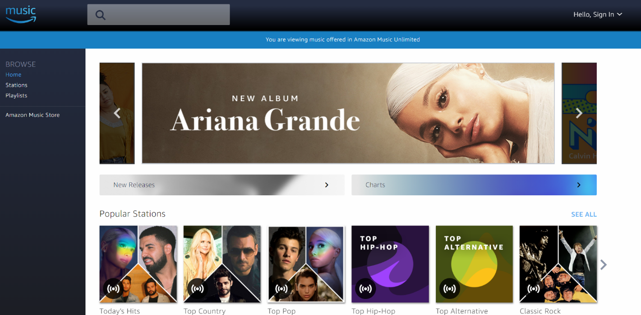
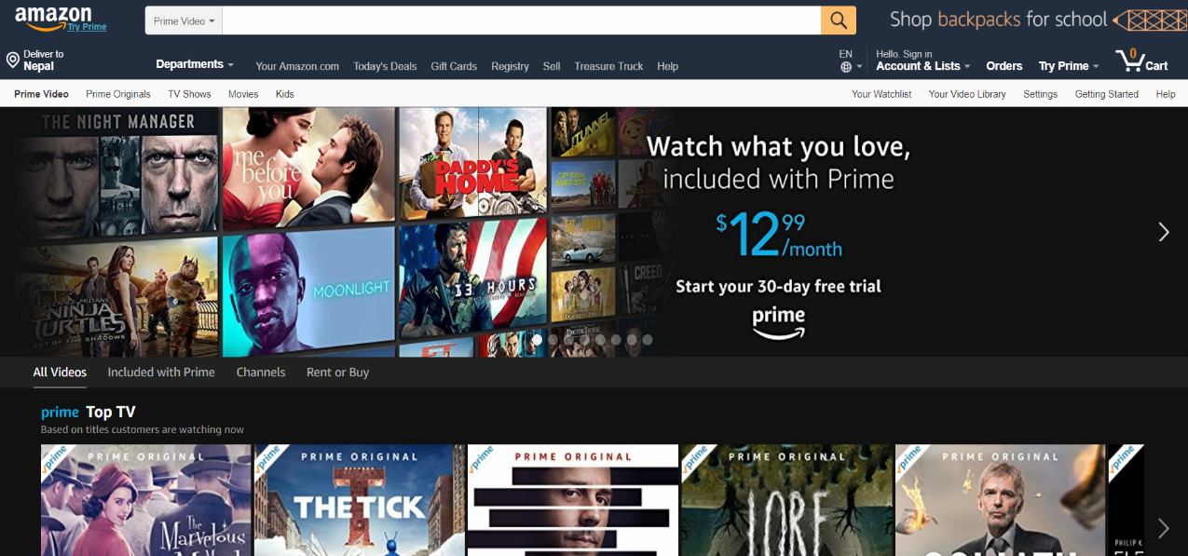
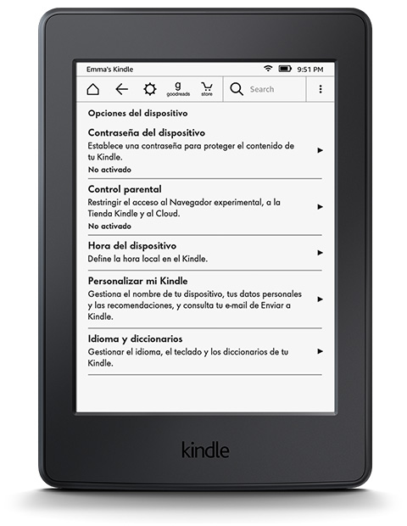
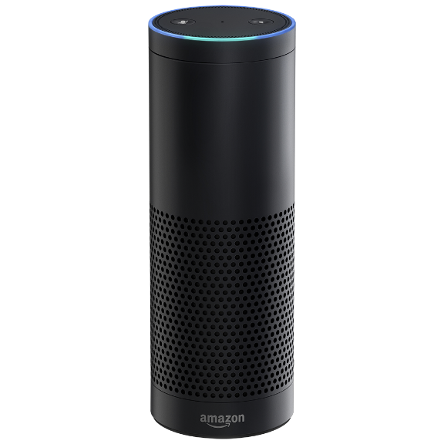
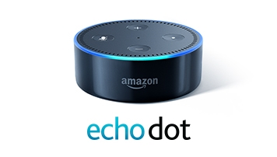
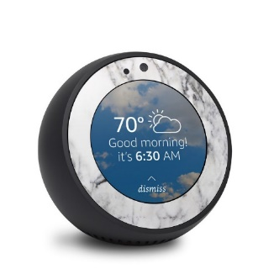
Amazon Music and Video
Kindle, Alexa and Echo

Slide 27
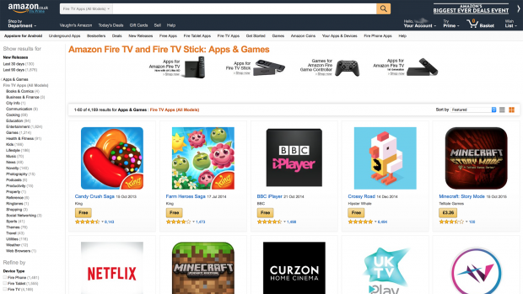
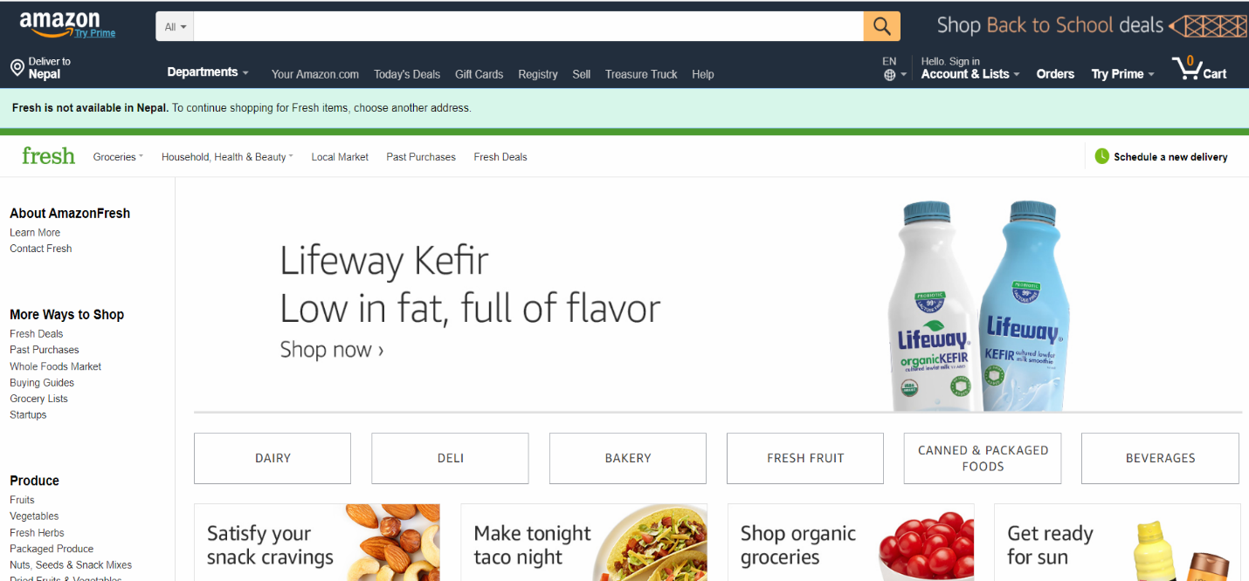
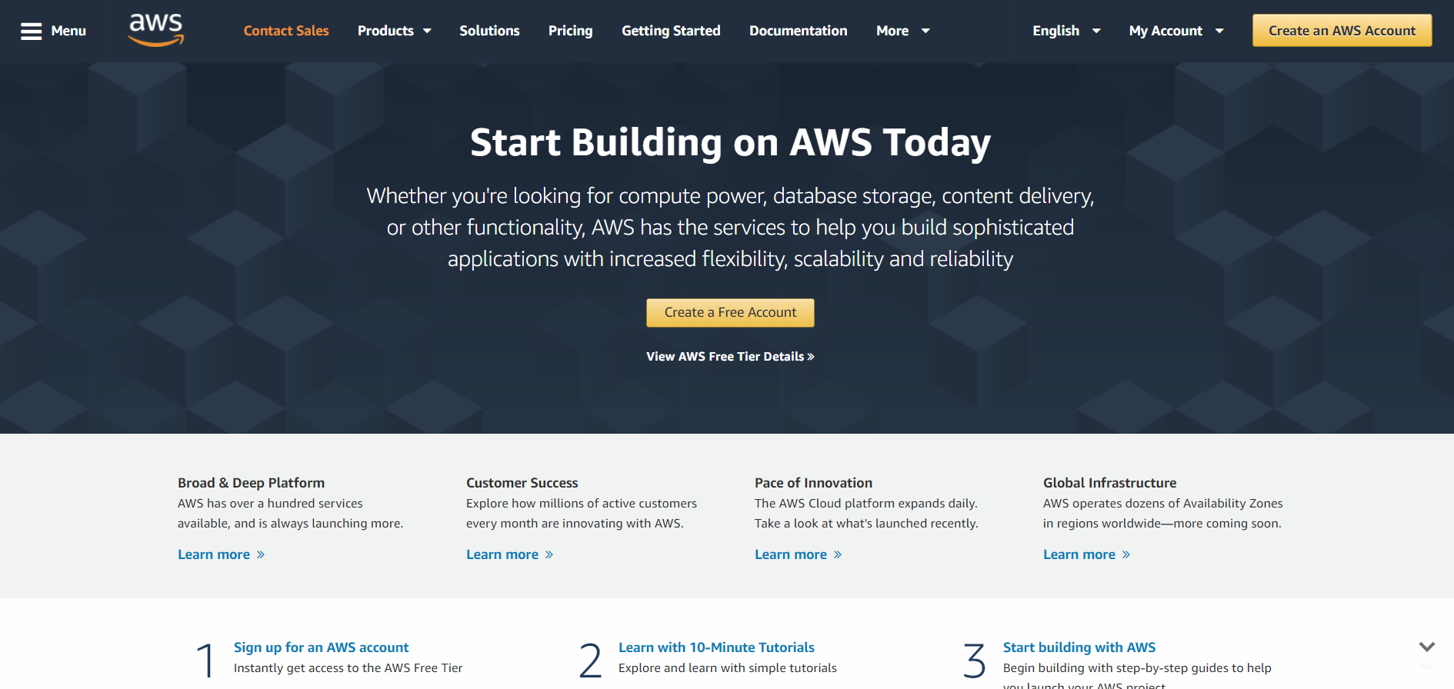
Amazon Appstore
Amazon Fresh
Amazon Web Services

Slide 28

ANY QUESTIONS FOR US?

Slide 29



